Slide 1
BEST PRACTISE MAKING ANDROID APP
Advanced Native Mobile Programming
Week 14
Universitas Surabaya - Teknik Informatika

Slide 2
PUBLISHING APP
01
In PlayStore

Slide 3
PUBLISH APP
Google Play is one of the largest platforms for distributing, promoting, and selling Android apps.
Rules, regulations, and procedures (subject to change)

Slide 4
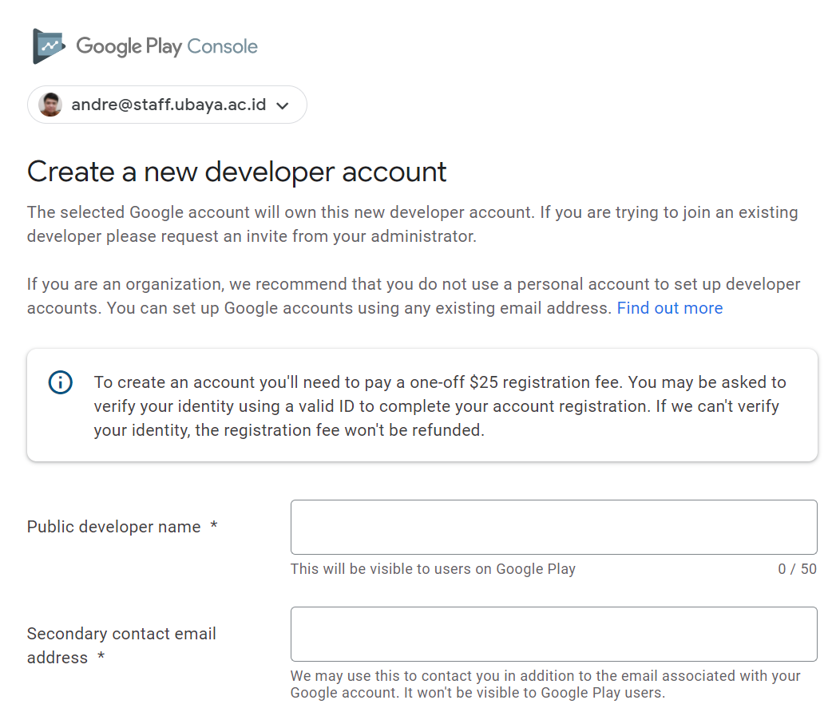
DEVELOPER ACCOUNT
First you need developer account. Visit: https://play.google.com/console/u/0/signup

Slide 5
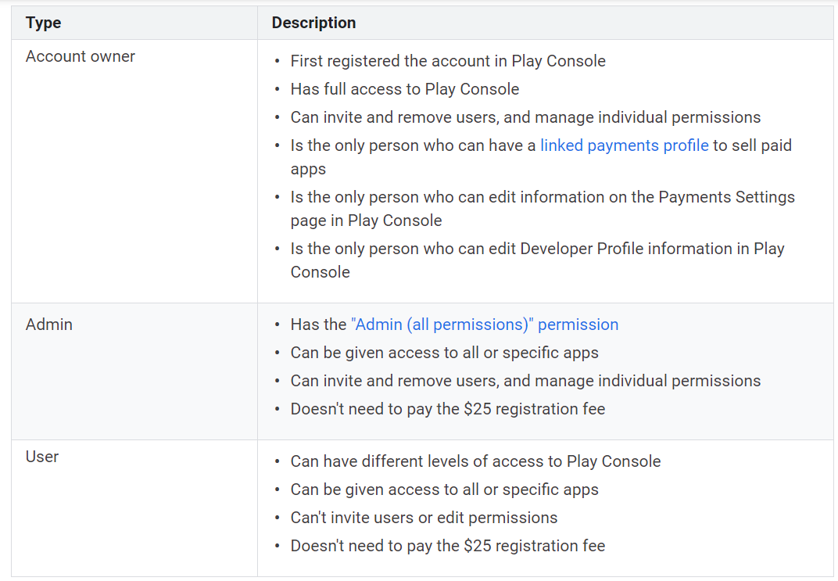
ACCOUNT ACCESS LEVEL

Slide 6
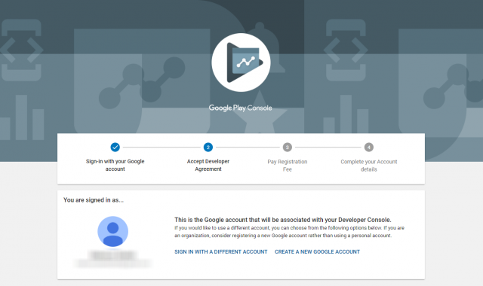
DEVELOPER ACCOUNT
You’ll need to pay a one-time registration fee of $25 (lifetime)
Publish unlimited number of apps

Slide 7
APP BUNDLE
Starting August 2021, new apps will be required to publish with the Android App Bundle on Google Play
It's a new official Android publishing format that offers a more efficient way to build and release your app.
Smaller file size compared to APK

Slide 8
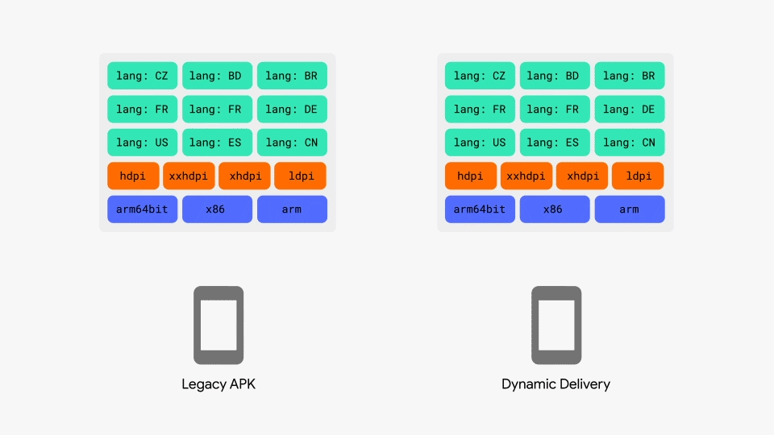

Slide 9
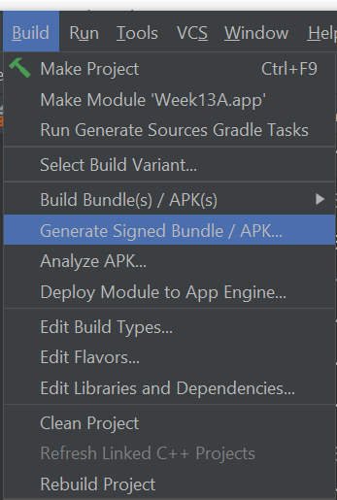
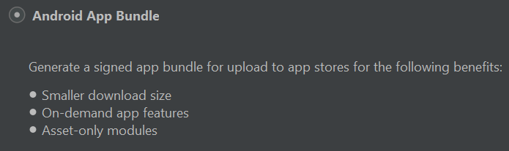
HOW TO CREATE APP BUNDLE
To create app bundle, click menu Build > Generate Signed Bundle / APK
Choose “Android App Bundle” and click next

Slide 10
KEYSTORE
Android requires that all APKs be digitally signed with a certificate before they are installed on a device or updated.
If you use Android App Bundles, you need to sign only your app bundle before you upload it to the Play Console, and Play App Signing takes care of the rest

Slide 11
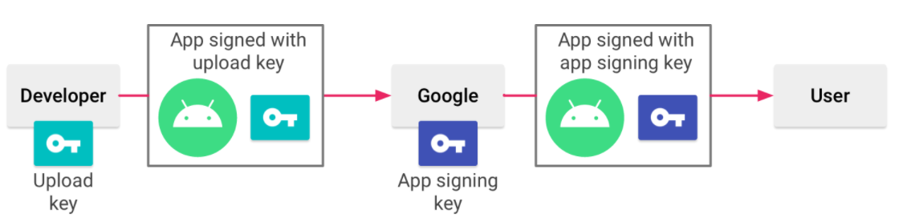
DOUBLE SECURITY
When you are ready to publish, you can sign your app using Android Studio upload it to Google Play. The key with which you sign your app becomes your app’s upload key
You aren’t able to download the signing key from Google

Slide 12
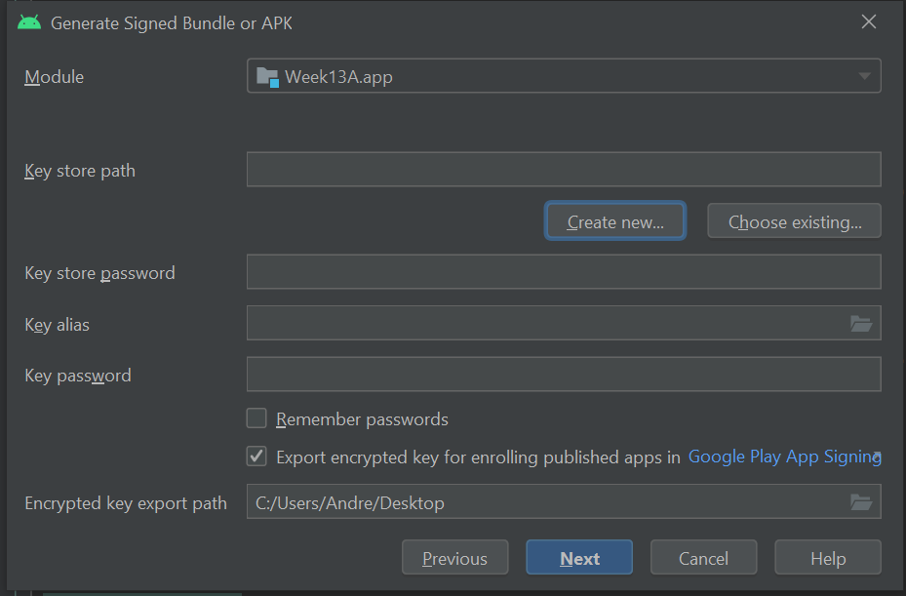
KEYSTORE
To create a new keystore, click “Create new”

Slide 13
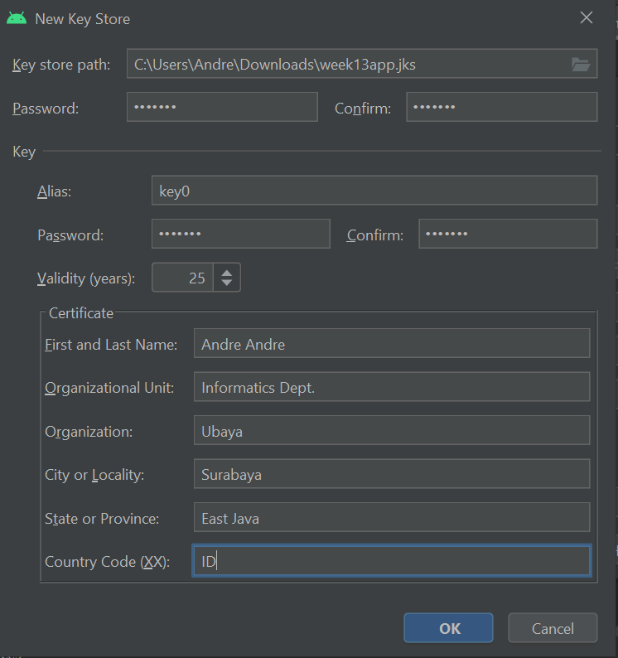
HOW TO CREATE APP BUNDLE
You need to store your password securely
Everytime you need to update your app Android Studio will ask for the password
This process called “self signed key”

Slide 14
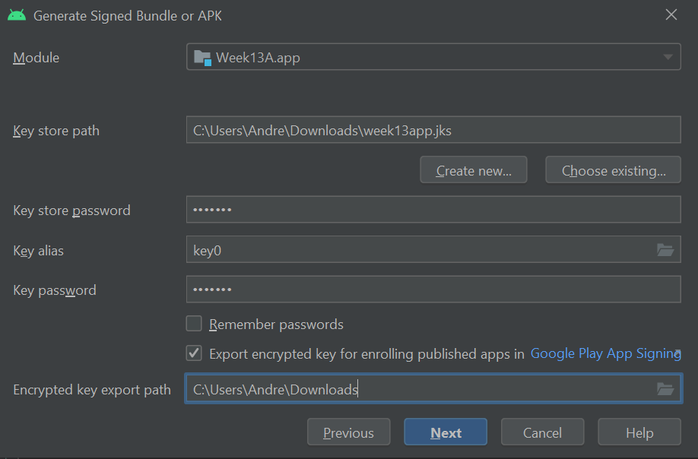
HOW TO CREATE APP BUNDLE
Always tick for “Export encrypted key for enrolling published apps in Google Play”
Press Next

Slide 15
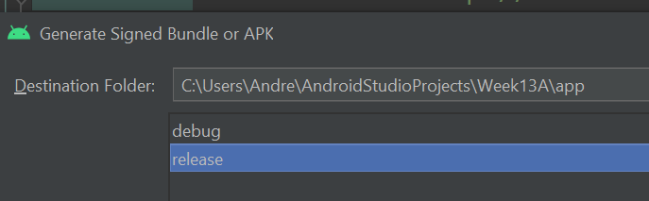
KEYSTORE
Choose “Release” Generated Bundle App will located at the destination folder
Press Finish and then wait until Gradle process finish

Slide 16
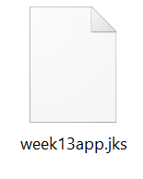
WARNING!
This is the keystore file. Keep it somewhere safe. It will be required every time you update the app. If you lose it or forgot the password, you won't be able to update your app in Play Store.

Slide 17
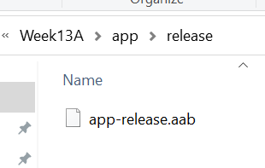
THE APP BUNDLE
In the destination folder, you will find the App Bundle (.aab extensions). This files is your app. Therefore you’ll need this to publish the app in PlayStore.

Slide 18
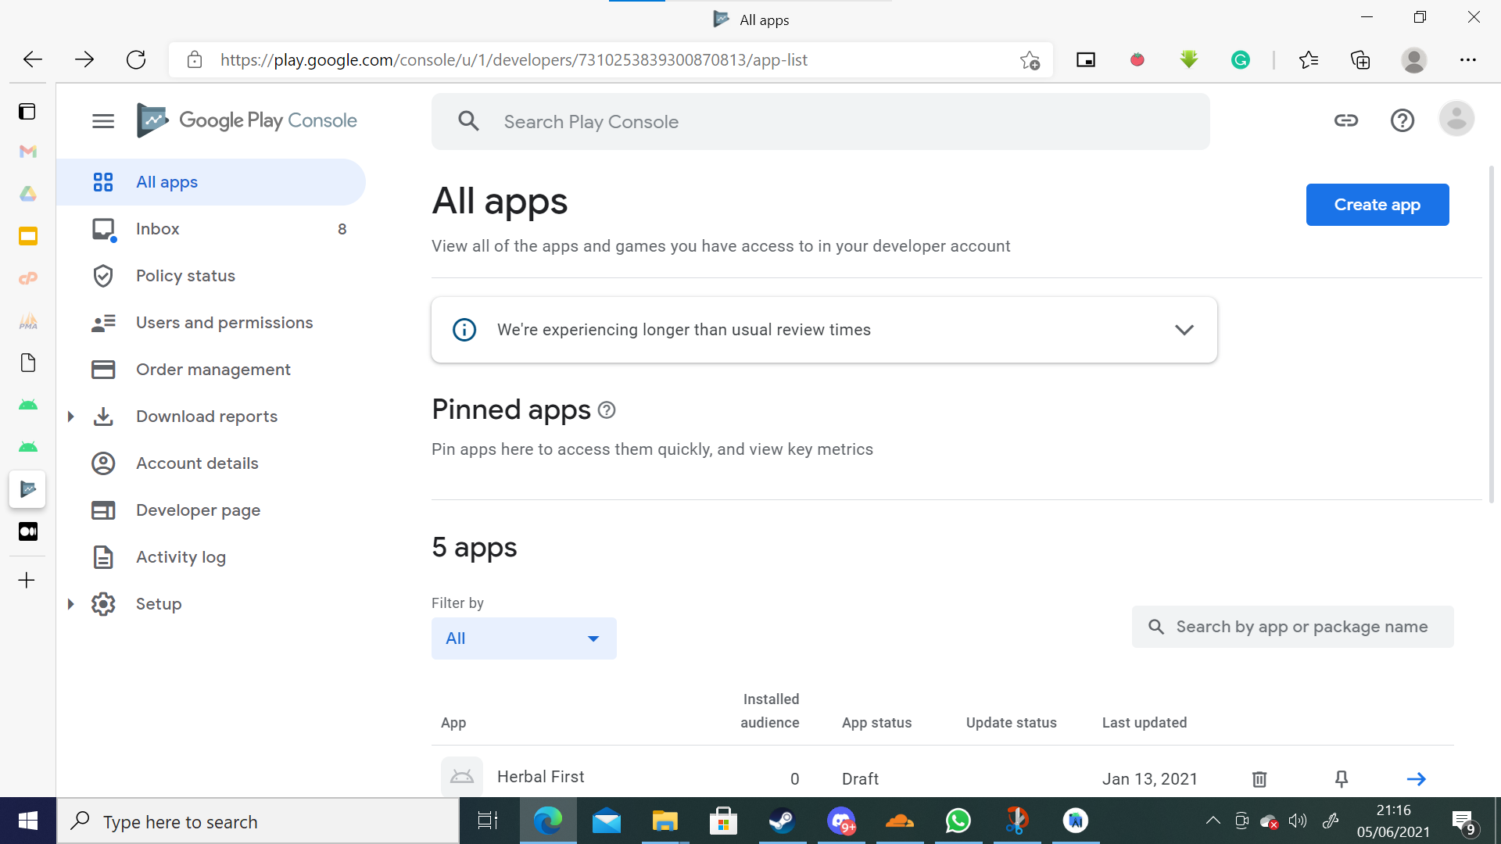
PLAY CONSOLE DASHBOARD

Slide 19
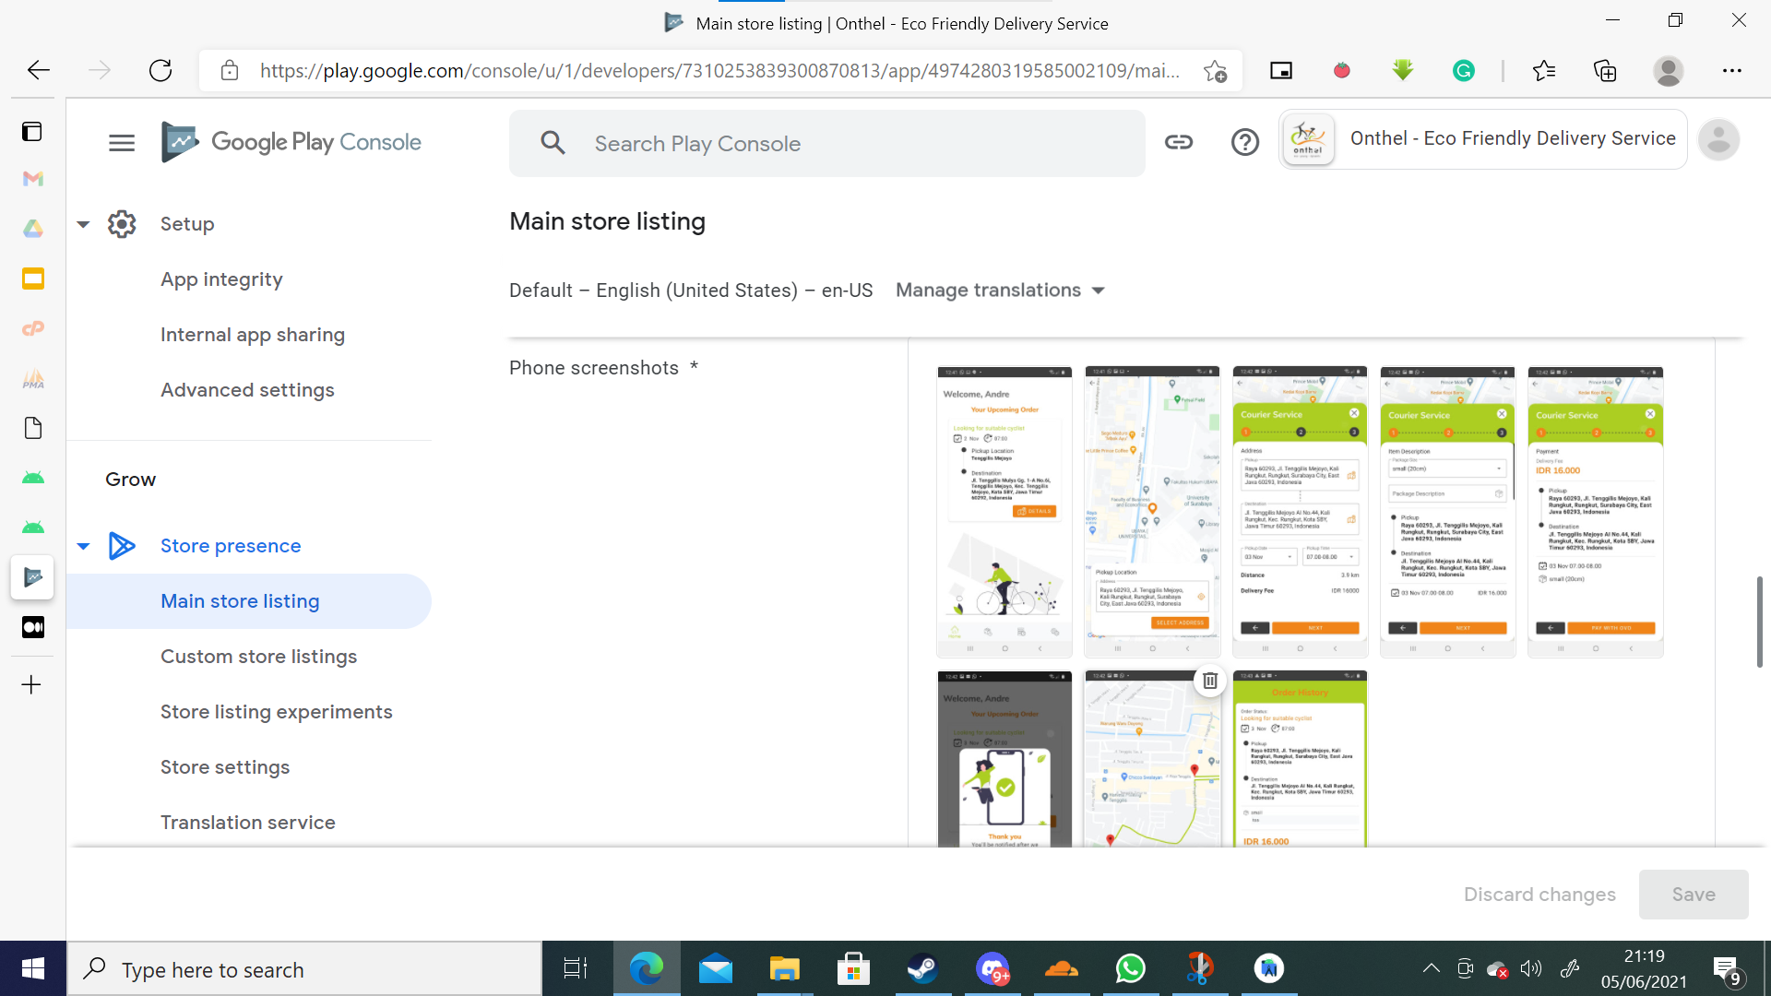
CREATE APP

Slide 20
PUBLISH THE APP
Before you really release the app for public, you should test your app with specific groups or open your test to Google Play users.
The term release here is where you release the app either for testing purposes or production release
There are three testing phase:
Internal testing
Closed testing
Open testing

Slide 21
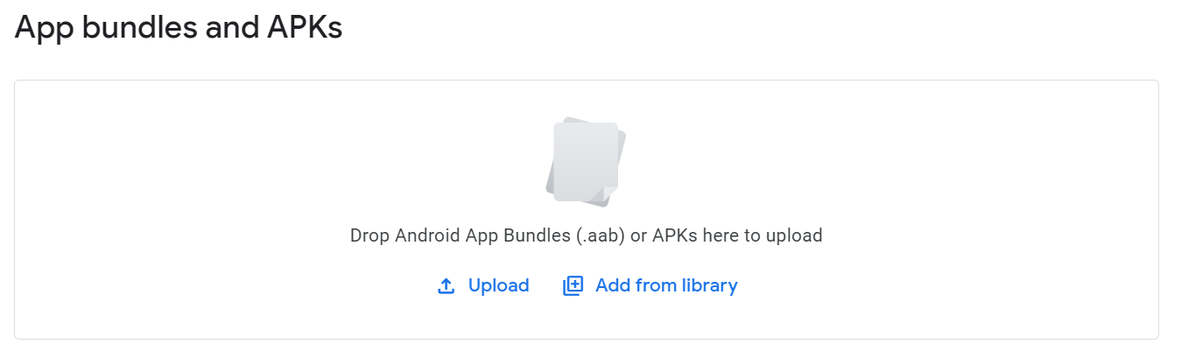
INTERNAL TESTING
Create an internal testing release to quickly distribute your app to up to 100 testers for initial quality assurance checks.
Manually add users as tester
On each release you need to upload the .aab file

Slide 22
CLOSED TESTING
Create a closed testing release to test pre-release versions of your app with a wider set of testers to gather more targeted feedback.
With a closed test, you can create a list of testers by email address. You can create a total of 200 lists, and each list can have up to 2,000 users

Slide 23
OPEN TESTING
Create an open testing release to run a test with a large group and surface your app's test version on Google Play (beta).
User can download and try your app. Your app also visible and searchable in PlayStore
User cant give rating yet

Slide 24
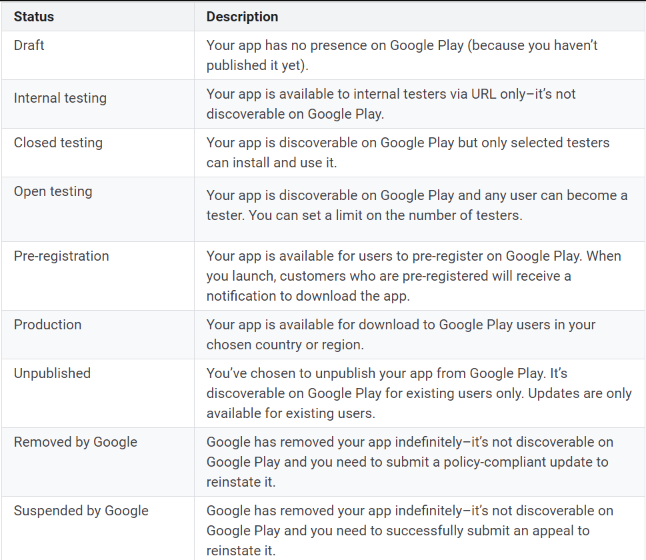
APP PUBLISH STATUS

Slide 25
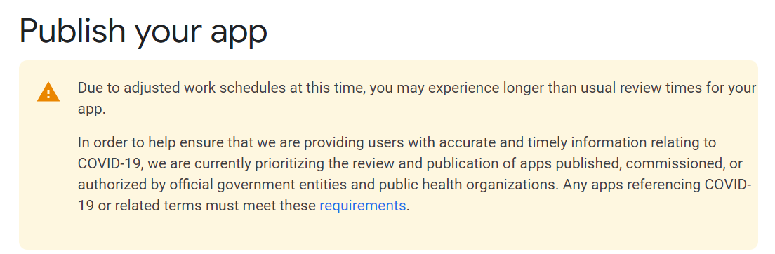
GOOGLE REVIEW YOUR APP

Slide 26
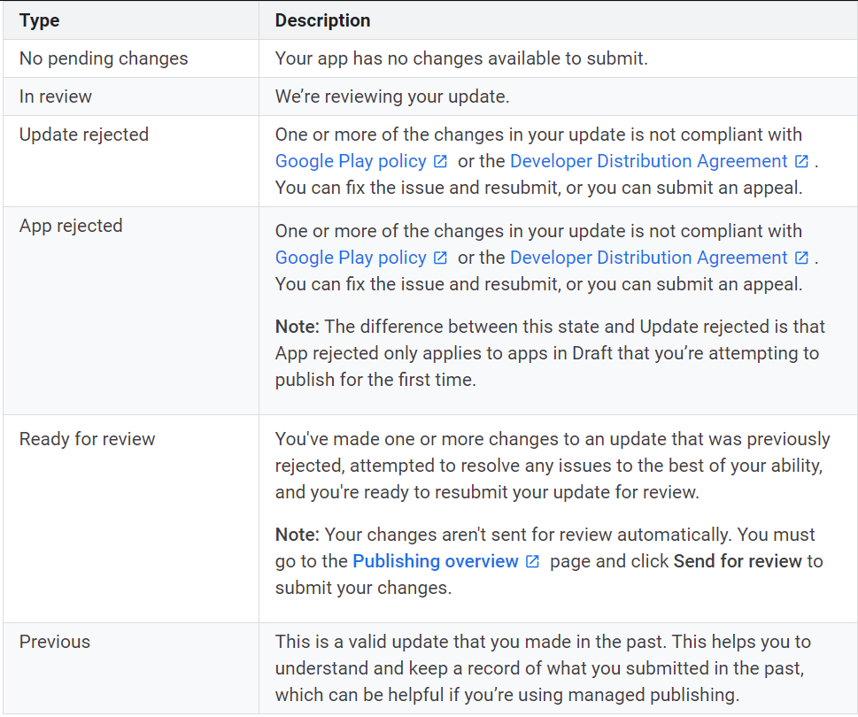
APP UPDATE STATUS

Slide 27
UPDATING OR UPGRADING APP
Sometimes the app need to be upgraded due to three common reasons:
Bug fixing
New features
Remove features

Slide 28
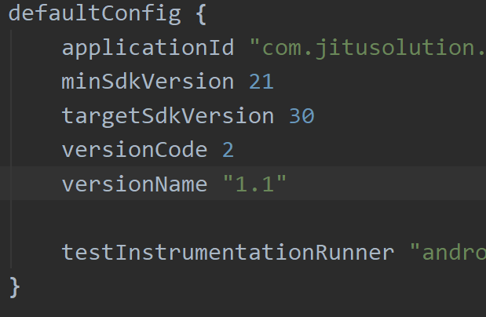
APP VERSION
Before generate app bundle, app version needs to be increased each time for the new upgrade/update
Open the gradle module
Check for default config
Increase the versionCode by one
Change versionName to Whatever number you like (ex: 1.1a, 1.03)

Slide 29
TIPS PUBLISHING APP IN PLAYSTORE
Avoid the default name android studio project “myapplication” Google will reject it.
Give consideration to target API Level. Do some research for your target market and review the statistics data of smartphone targets.
Legal Issues (restricted content, intellectual property, forbidden content, malware, spam)
Target audience. Targeting children younger than 13 years old requires a privacy policy. If the app is designed for both children and adults, it needs to comply with Family Policy.

Slide 30
TIPS PUBLISHING APP IN PLAYSTORE
Apps require a website. Terms & Conditions should be accessible on the web.
Always allocate extra time before planning to publish the app. Additional times for the review and resolve the issues that might arise.
Provide information about user access (username and password) if your app requires authentication to sign in. The reviewer uses this to access your app features.
150 Mb is the maximum app size. Solution = Play Asset Delivery or Play Feature Delivery.

Slide 31
APP PERFORMANCE
02
ANR, Excessive Resources, Launching Time

Slide 32
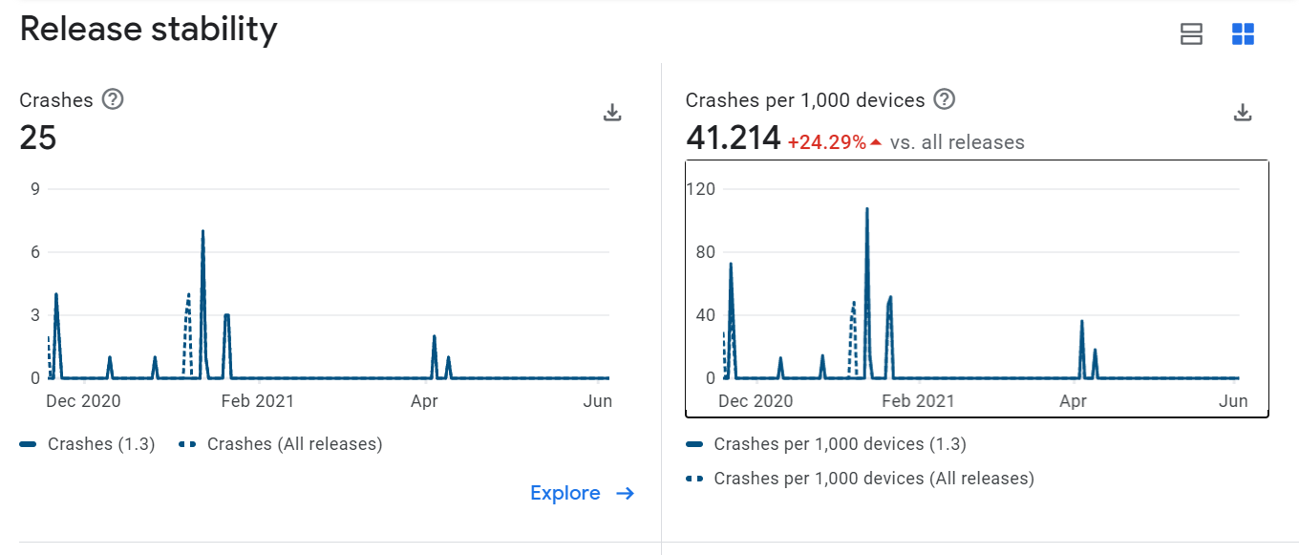
ANDROID VITALS
The dashboard highlights crash rate, ANR rate, excessive wakeups, and stuck wake locks: these are the core vitals developers should give attention to.

Slide 33
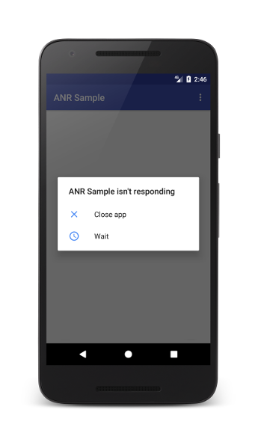
ANRs
When the UI thread of an Android app is blocked for too long, an "Application Not Responding" (ANR) error is triggered.
Caused by:
Not handled exception Ex: trying to set the text of an EditText component, but the EditText is null
Indefinitely loop or long process in MainThread

Slide 34
HOW TO PREVENT ANRs
Stop doing heavy tasks on the main thread. Instead use worker threads such as IntentService, AsyncTask Handler, or another Thread simply.
Check android vitals in Google Play Console to get more insight of the ANR

Slide 35
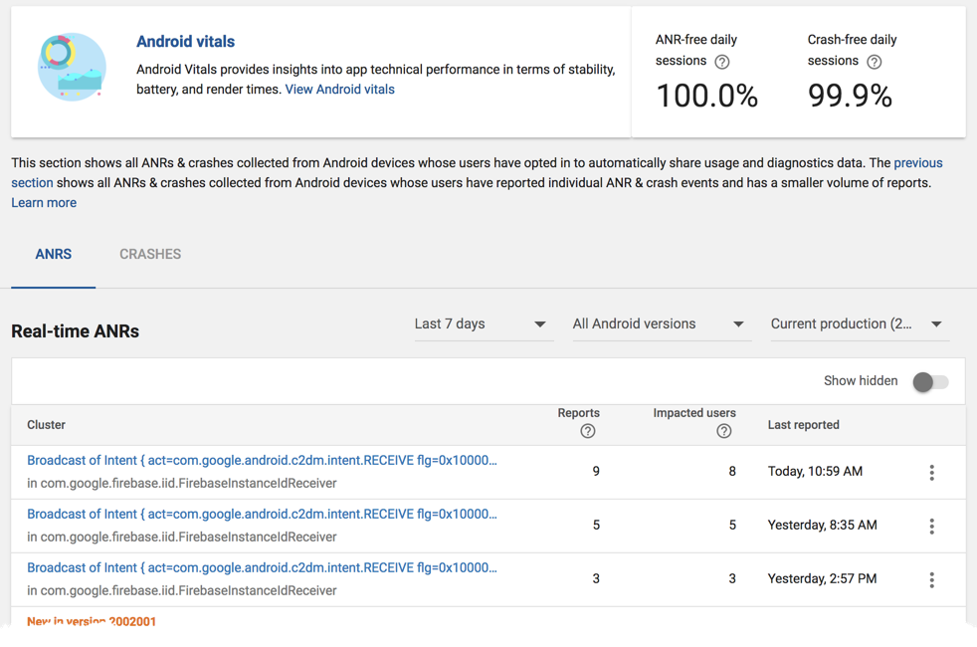
ANR VITALS

Slide 36
EXCESSIVE WAKEUPS
To extend battery life, after its screen turns off, an Android device enters a deep sleep mode by disabling the main CPU cores.
Android automatically monitors apps for excessive wakeup alarms and displays the information in Android vitals.
Wakeups seem like a good thing, bringing important events to the users’ attention, but too many of them and battery life suffers

Slide 37
EXCESSIVE BACKGROUND NETWORK USAGE
When an app connects to the mobile network in the background, the app wakes up the CPU and turns on the radio. Doing so repeatedly can run down a device's battery.
Android vitals considers background network usage excessive when an app is sending and receiving a combined total of 50 MB per hour while running in the background in 0.10% of battery sessions

Slide 38
APPS LAUNCHING TIME
App launch can take place in one of two states, each affecting how long it takes for an application to become visible to user.
Cold Start app’s starting from scratch
Warm Start system bring your activity to the foreground

Slide 39
IMPROVE APPS LAUNCHING TIME
Initialise only those objects that are immediately needed
Avoid nested layout if possible
Move all resource initialisation so that the app can perform it lazily on a different thread.
Allow the app to load and display your views, and then later update visual properties that are dependent on bitmaps and other resources

Slide 40
APP SECURITY
03
App chooser, ssl traffic, permission, reverse engineering

Slide 41
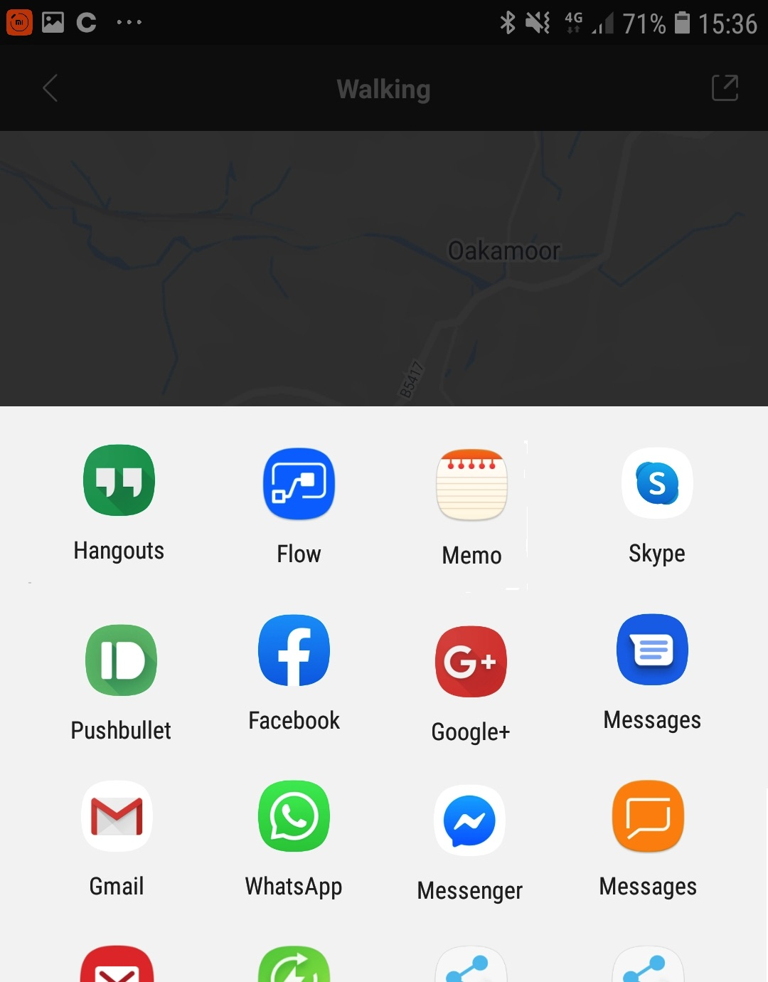
SHOWS APP CHOOSE IF POSSIBLE
If an implicit intent can launch at least two possible apps on a user's device, explicitly show an app chooser. This interaction strategy allows users to transfer sensitive information to an app that they trust.

Slide 42
SHOWS APP CHOOSER IF POSSIBLE
val intent = Intent(Intent.ACTION_SEND)
val possibleActivitiesList: List<ResolveInfo> = packageManager.queryIntentActivities(intent, PackageManager.MATCH_ALL)

Slide 43
SHOWS APP CHOOSER IF POSSIBLE
if (possibleActivitiesList.size > 1) { // Create intent to show chooser. // Title is something similar to "Share this photo with".
val chooser = resources.getString(R.string.chooser_title).let { title -> Intent.createChooser(intent, title) }
startActivity(chooser)
} else if (intent.resolveActivity(packageManager) != null) { startActivity(intent) }

Slide 44
USE SSL TRAFFIC
Always uses HTTPS secure REST API server
Whenever possible, load only allowlisted content in WebView objects. In other words, the WebView objects in your app shouldn't allow users to navigate to sites that are outside of your control.

Slide 45
PROVIDE THE RIGHT PERMISSION
Your app should request only the minimum number of permissions necessary to function properly. When possible, your app should relinquish some of these permissions when they're no longer needed.

Slide 46
STORE DATA SECURELY
By default, files that you create on internal storage are accessible only to your app. Android implements this protection, and it's sufficient for most applications.
Generally, avoid the MODE_WORLD_WRITEABLE or MODE_WORLD_READABLE modes.

Slide 47
PERFORM INPUT VALIDATION
Always check for user input
Handle the user data properly before submitting to the next process (i.e: send to rest api, stored into sqlite, stored into shared preferences, send through intent, and so on)

Slide 48
REVERSE ENGINEERING
Decompile APK into android studio project or java codes!
How to avoid:
Put important code on a server
Use ProGuard Proguard is free Java class file shrinker, optimizer, obfuscator, and preverifier. It detects and removes unused classes, fields, methods, and attributes.

Slide 49
THANKS
Do you have any questions?
andre@staff.ubaya.ac.id
Please keep this slide for attribution

Slide 50


